Slide 1


Compliant Control
Andrea Calanca
Notes:
Welcome to this tutorial on compliant control …
I am andrea calanca the tutorial organizer. Accordingly to the online schedule I will give the first presentation introducing estabilished concepts of compliant control. Then we will listen the words of … then both proposed recent advances in the area. Then I will give a final presentation introducing a novel approach to control.

Slide 2
Outline
Preliminary Concepts
Compliant Control of Stiff Joints
Compliant Control of Soft Joints
Discussion & Conclusions
Notes:
To go deep into compliant control technology this tutorial will be divided into 4 parts

Slide 3
Part I: Preliminary concepts

Slide 4
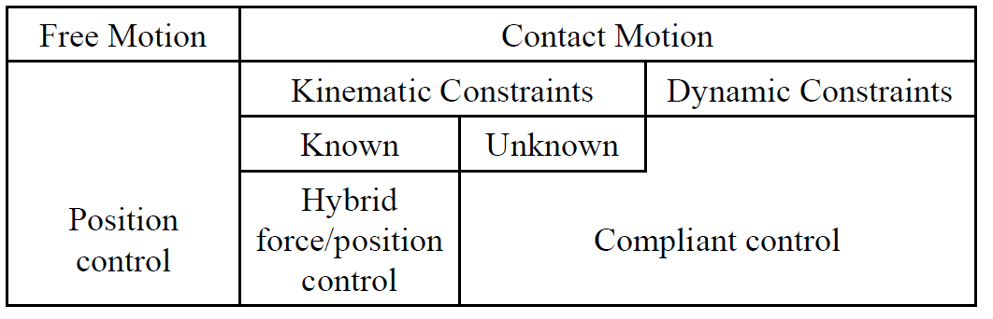
Interaction Control
Interaction control is technology to control physical interaction with the environment, i.e. forces and positions.
Can you control both?
Notes:
First of al what is compliant control. Actually it is the technology we have to shape the mechanical impedance of a mechatronic system.
Which basically means to shape the (dynamical) relation between position and force.
Among different control systems position control can be used only in free motion (when there is no environment) and hybrid fp control can be used only when the environment geometry is exactly known. However when the environment is unknown or it contains some dynamical systems like in the case of pHRI where the environment contains is identified with a human you need to use compliant control. In fact the main advantage of CC wrt position or hybrid control is that by shaping the impedance we implicitly shape the energy exchange with the environment which implies augmented safety and robustness.
(Compliant control need to be used any time we need to interact with an unknown environment or dynamic environment )

Slide 5
Compliant Control
Compliant control is technology to control the compliance, the mechanical impedance of a mechatronic system.
Compliant control shapes the (dynamical) relation between position and force
Notes:
First of al what is compliant control. Actually it is the technology we have to shape the mechanical impedance of a mechatronic system.
Which basically means to shape the (dynamical) relation between position and force.
Among different control systems position control can be used only in free motion (when there is no environment) and hybrid fp control can be used only when the environment geometry is exactly known. However when the environment is unknown or it contains some dynamical systems like in the case of pHRI where the environment contains is identified with a human you need to use compliant control. In fact the main advantage of CC wrt position or hybrid control is that by shaping the impedance we implicitly shape the energy exchange with the environment which implies augmented safety and robustness.
(Compliant control need to be used any time we need to interact with an unknown environment or dynamic environment )

Slide 6
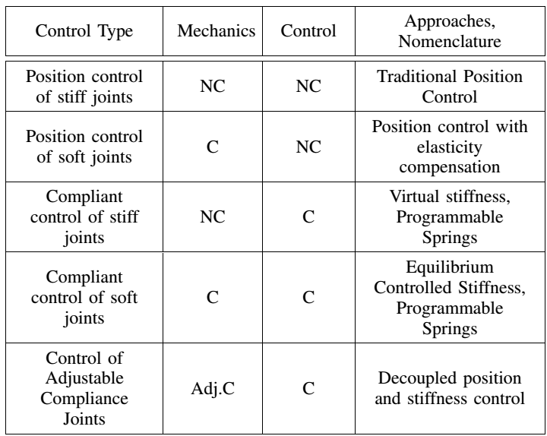
Compliant Control
Notes:
In this table you can see the different combinations of C and NC mechanics with C and NC control. And you can see that the final compliance of the system mainly depends on the compliant nature of the controller. As example you can see that if the mechanics is compliant but the controller is not we basically have position control which try to compensate for elasticities thus producing a stiff system. Otherwise compliant control on non compliant mechanics produces a final compliant result.
In this tutorial we focus on the cases when the controller is compliant while the mechanics can be stiff or soft.

Slide 7
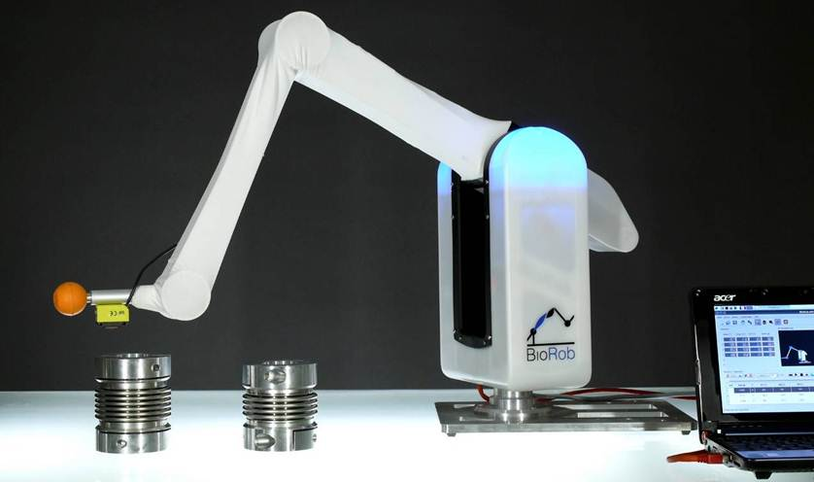
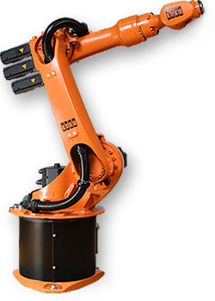
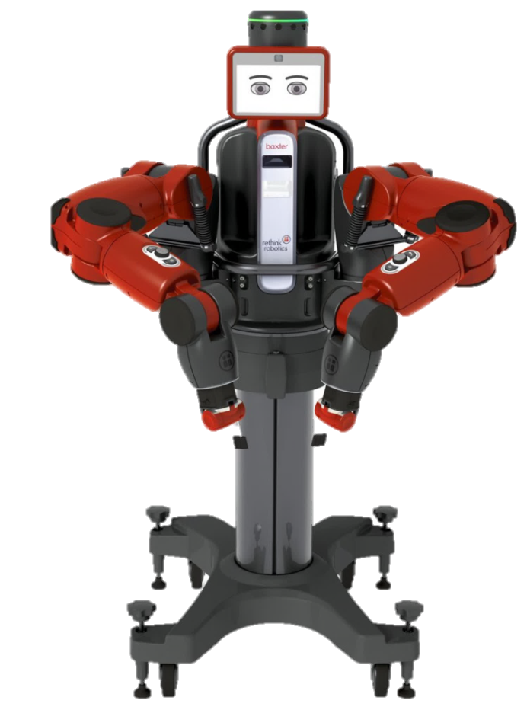
Compliant Control
Two main research areas:
Stiff Joint Control Long history, 50s
Soft Joint Control More recent, 90s
Different history, background and nomenclature but quite similar architectures and control principles
Notes:
And we need to say that the literature on stiff robot control have some peculiar differences wrt literature on soft joint control an these differences are mainly due to historical reasons. In fact…
However despite different background and nomenclature stiff and soft joint control share similar control architecture and control principles

Slide 8
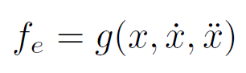
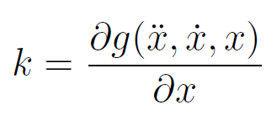
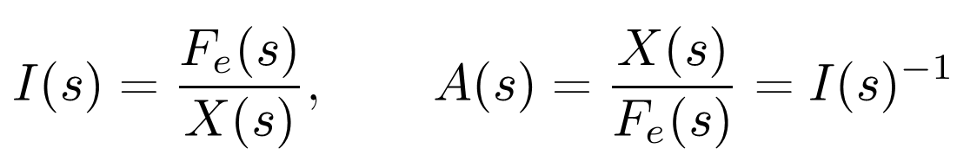
Compliance, Impedance & Admittance
Mechanical system
Stiffness definition:
Compliance is the reciprocal of stiffness: the ability to exhibit displacement if a force is applied.
Impedance and admittance describe the dynamical relations between force and velocity.
Notes:
We need to start first with the definition of compliance. If we consider a mechanical system in the companion form where f_e are the external force from the environment stiffness is traditionally defined as the derivative wrt displacement.
Compliance (in strict sense) is … and in general is
Also we have Impedance and Admittance that can be seen as the dynamical counterpart of stiffness and compliance and both describe …

Slide 9
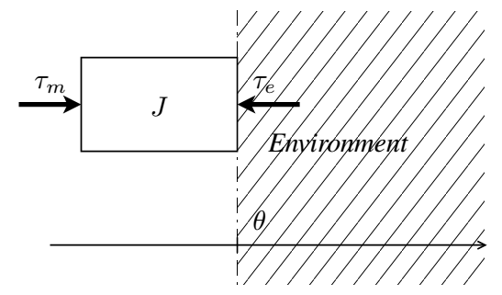
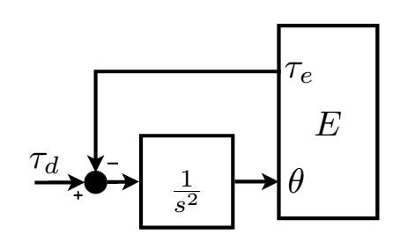
Backdrivability
Mechanical backdrivability
Direct power flow from the environment to the motor
Prevented by energy losses and kinematic inefficiencies in the transmission system
Notes:
Also we have a further concept which is sometime confused with compliance. It is mechanical backdrivability.
In a backdrivable motor we have that the motor (rotor) inertia is moved not only moved by actuator torque but also by environmental torque. Meaning that there is …
Despite this can seem obvious this is not always true in practice if we use high gear ratio transmissions. In such cases we have that the inherent transmission friction is magnified by the transmission ratio and it is not possible to move the motor from the outside especially in static conditions where we need to overcome the stiction threshold. In general you can find in the literature that backdrivability depends on transmission efficiency and you have backdrivability when the efficiency is greater than 50%.
If we think in term of block diagram one can easily see that backdrivability is represented by this arrow which reports the environmental torques at motor input.

Slide 10
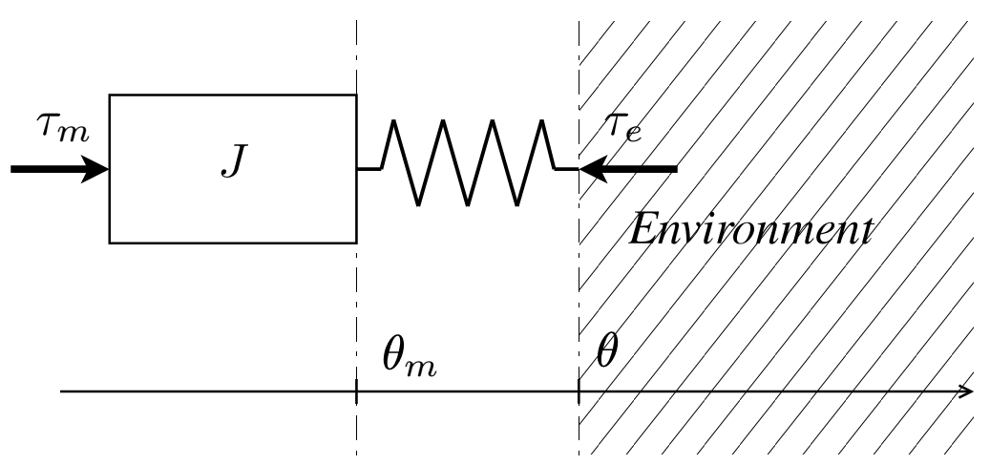
Backdrivability & Compliance
Mechanical Compliance
In compliance there is no need for a direct power flow from the environment to the motor, there only a need for a “soft” dynamics.
Notes:
As backdrivability is sometimes confused with compliance which is a very different concept. It just considers the presence of a compliant element between the motor and the environment. Of course if the motor is backdrivable it can exhibit a certain compliance but compliance can be achieved even in the case of stiff non backdrivable motors (massona).
In paricular we can say …

Slide 11
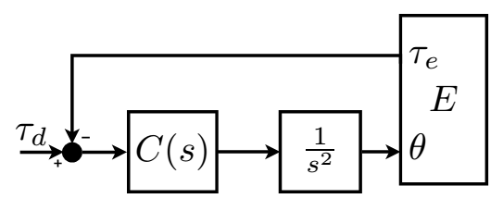
Backdrivability and Control
When it is not possible to use an appropriate mechanism backdrivability can be achieved by control.
Closing a force loop means to virtually transfer the sensed forces to motor input
Note: if we aim at position control non-backdrivability is recommended
Notes:
The relation between backdrivability and control is quite interesting.
On one hand we have that backdrivability can be achieved by force control. In fact when we close a force loop we basically virtually transfer the sensed forces to motor input, replacing the missing backdrivability arrow.
Interesting is also that non-backdrivability is recommended for position control. In fact in a non-backdrivable mechanics environmental forces, environmental disturbances cannot move the robot from its desired position.

Slide 12
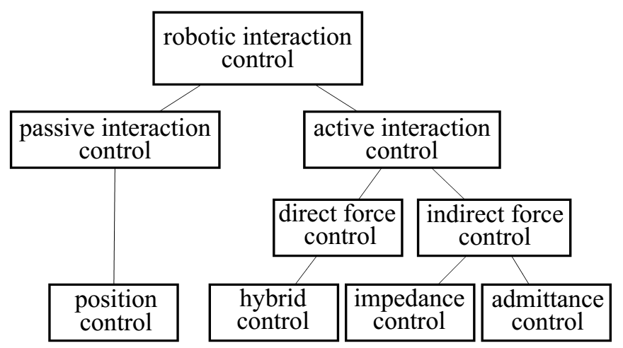
Taxonomy and Classification
Traditional interaction control classification
[Springer Handbook of Robotics 2008]
Notes:
After introducing the main foundamental concepts about compliant control we start by taking a look to the robotic interaction control taxonomy that you can find in the [Springer Handbook of Robotics 2008]
You can see here that we have two kind of interaction control …
Passive interaction control in this nomenclature means that we basically have a robot with some physical compliance but only at the end effector and we just control the robot in position (before the compliance). In such a case the compliant element just passively displays its inherent compliance. Actually the compliant element was called remote center of compliance and just allow to do some industrial task like the peg in a hole task but the robot is controlled using the industrial position control paradigm. In this case we have that the compliance is entirely due to the mechanics an not to the control that ‘s why it is called passive ic.
On the opposite hand we have the active interaction control approach where the mechanics is stiff an the compliance is entirely due to the control action. Here we have some indirect methods which basically uses position and force control on orthogonal subspaces (which depends on environment kinematic constraints (assumed known))
Finally we have indirect force control methods which represents the only approaches that aims to shape the robot impedance or admittance, to shape the dynamical relation between positions and forces.

Slide 13
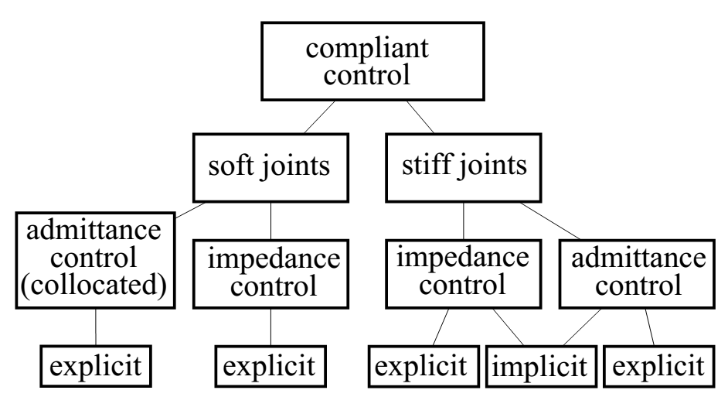
Taxonomy and Classification
Traditional interaction control classification do not account
for mixed active/passive approaches
for peculiar differences between control of stiff and soft joints
Notes:
Unfortunately this nomenclature cannot account for mixed active-passive approaches
So if you want to introduce the recent research on soft joint you need to expand the indirect force control node to include both stiff and soft joint cases which both includes some impedance and admittance implementations that will be described in the following two parts of this tutorial.

Slide 14
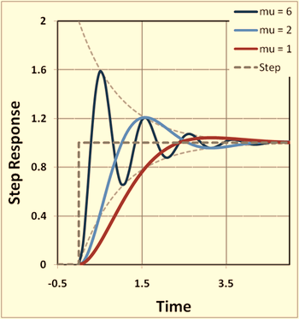
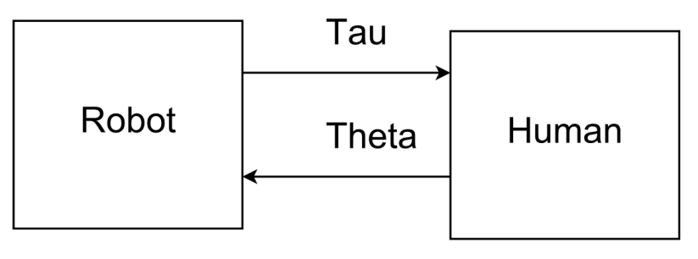
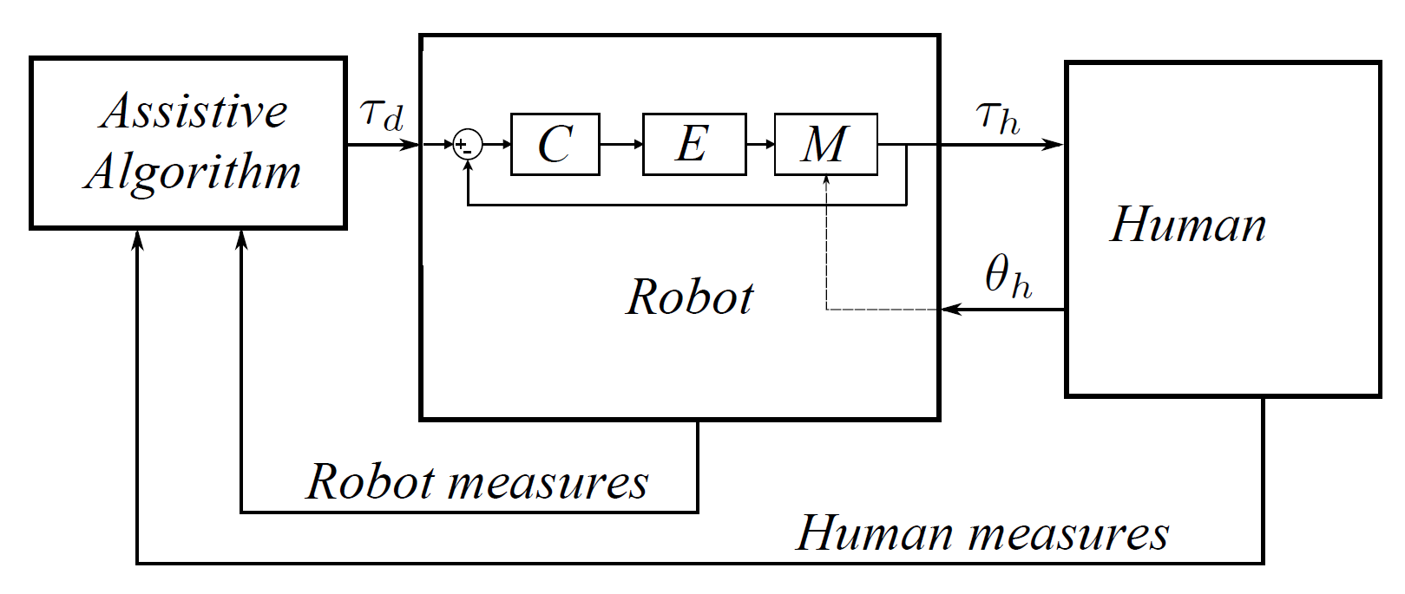
A Peculiar Force Control Issue
No matter the available power, the unpredictable nature of human beings (or unstructured environments) can influence closed loop dynamics
?
Notes:
However there is another limitation, issue, which is not given by series compliance but is a intrinsic force control issue. The performance one achieve do not only depends on the robot but also on the environment the robot is in contact with, in our case the human. If one tells you that his controller has a 10Hz bandwidth, you should ask in which condition an he will probably answer in a rigid environemnt. As the environemnt become softer the control bandwidth will decrease.

Slide 15
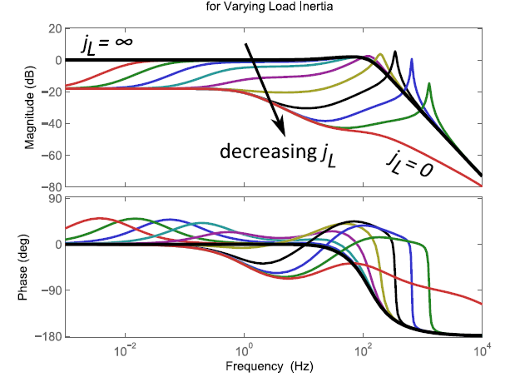
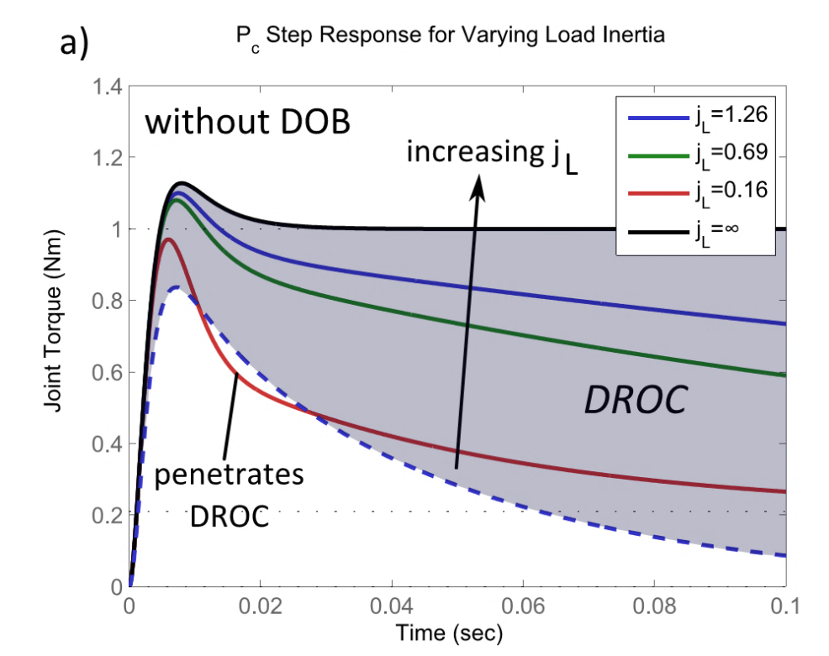
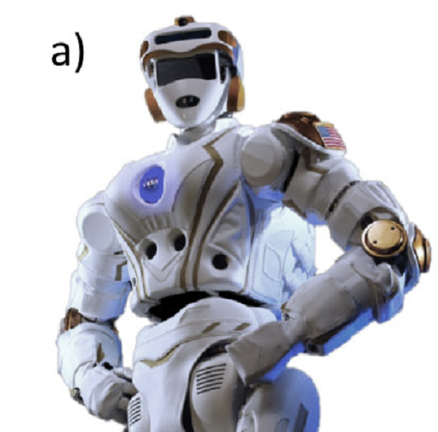
A Peculiar Force Control Issue
SEA with variable load inertia [1]
[1] N. Paine, J. S. Mehling, J. Holley, N. a. Radford, G. Johnson, C.-L. Fok, and L. Sentis, “Actuator Control for the NASA-JSC Valkyrie Humanoid Robot: A Decoupled Dynamics Approach for Torque Control of Series Elastic Robots,” J. F. Robot., p. n/a–n/a, 2015.
Notes:
This is just an example where researches showed the issue. These are different force control responses because of differen arm configurations of valkirie robot.

Slide 16
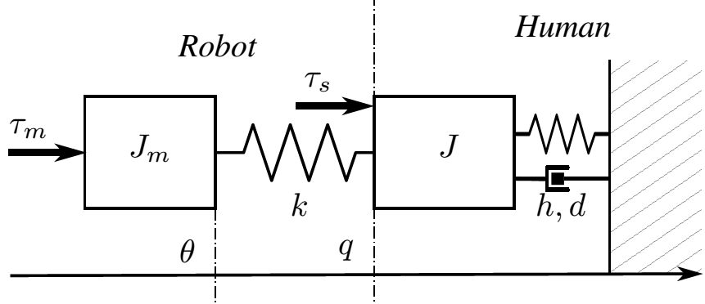
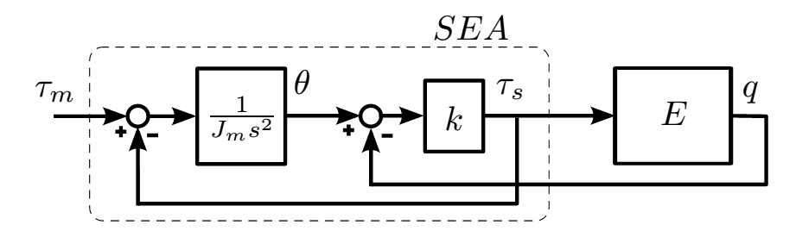
A Peculiar Force Control Issue
Let’s try to understand the issue
The “plant” depends on the environment!!

Slide 17


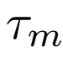
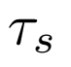
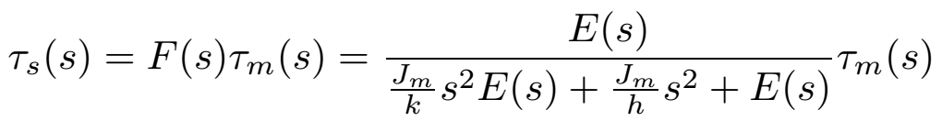
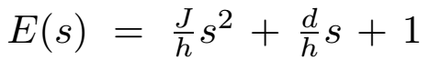
A Peculiar Force Control Issue
The plant is the to transfer function
The “plant” depends on the environment!!

Slide 18
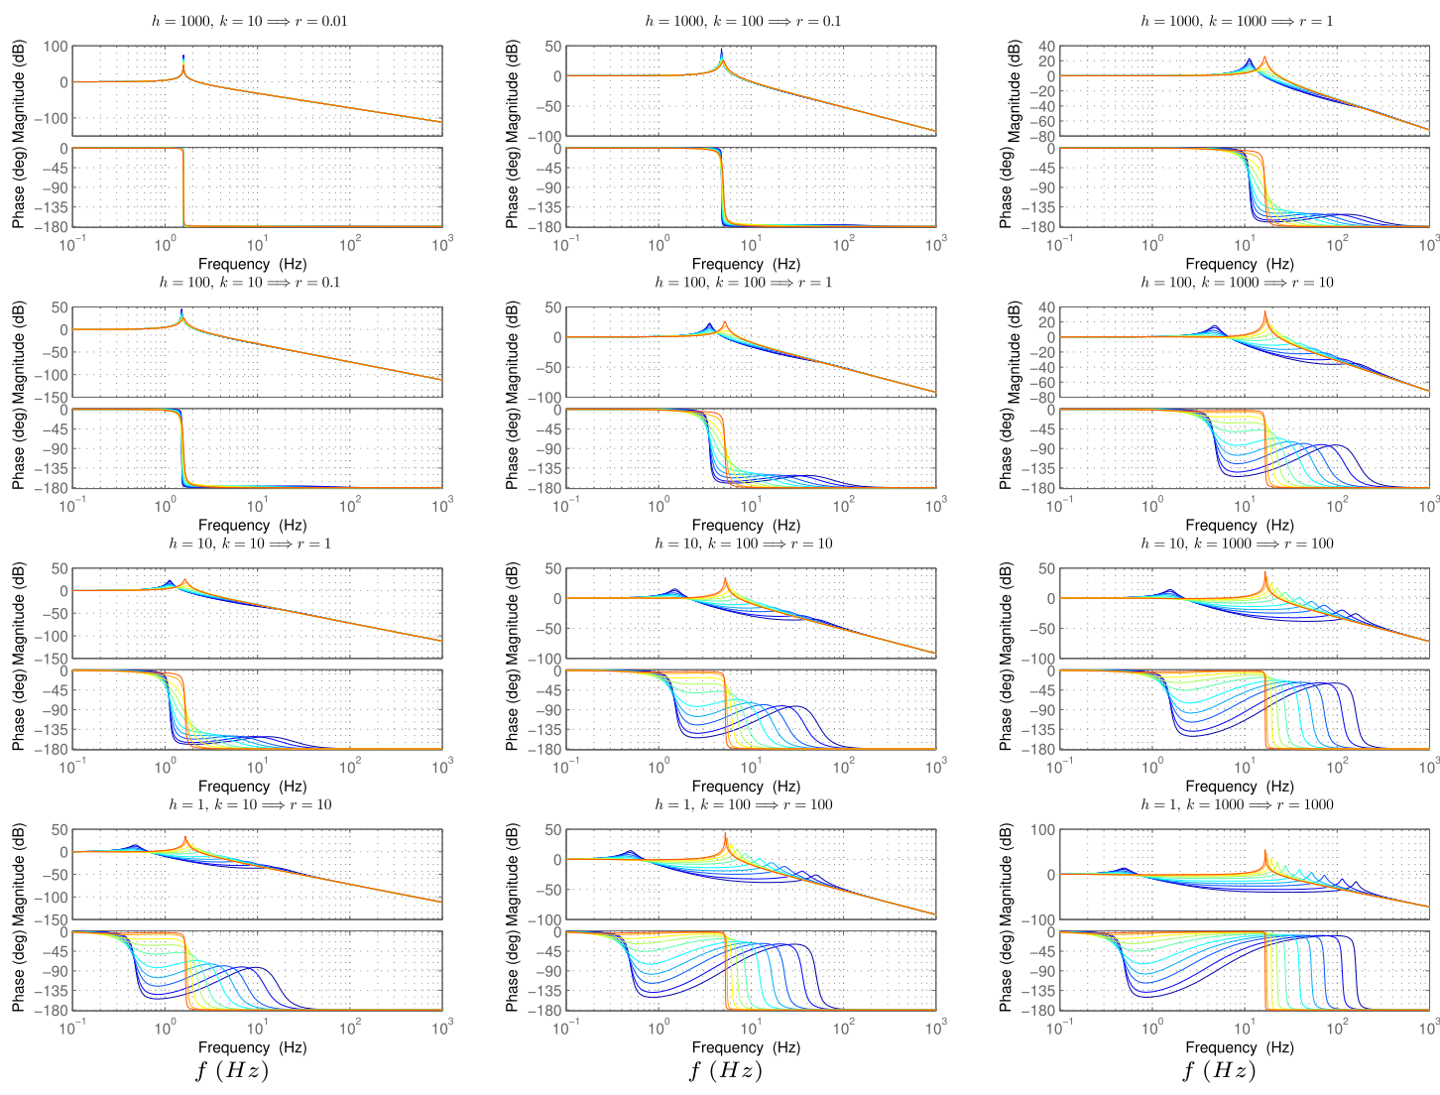
plots with different colors are related to different environment inertia J ∈ [0.001,1000] Kgm2 (from blue to red J is increasing). The actuator inertia Jm = 0.1 Kgm2 is constant in all figures and plots.

Slide 19
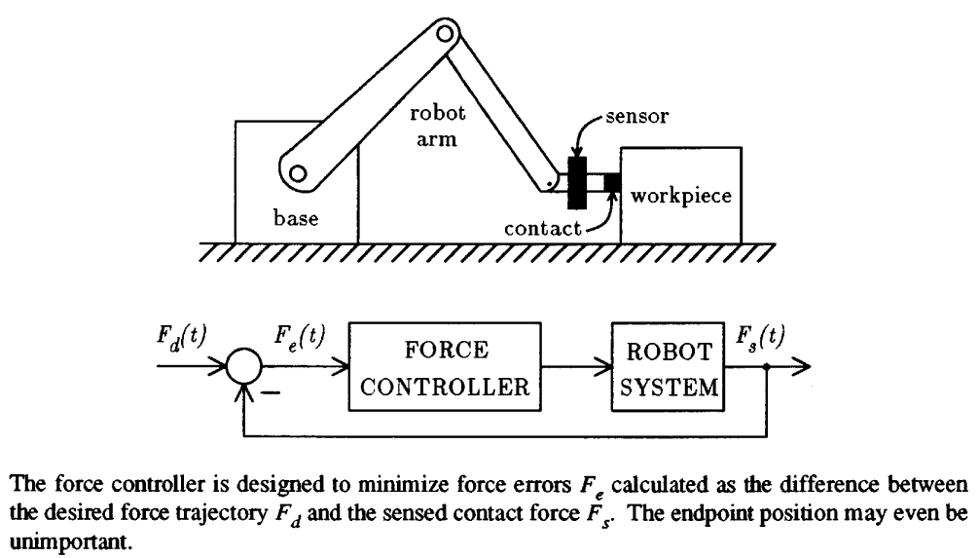
Force Control
S. Eppinger and W. Seering, “Understanding bandwidth limitations in robot force control,” Proceedings. 1987 IEEE Int. Conf. Robot. Autom., vol. 4, pp. 904–909, 1987.

Slide 20
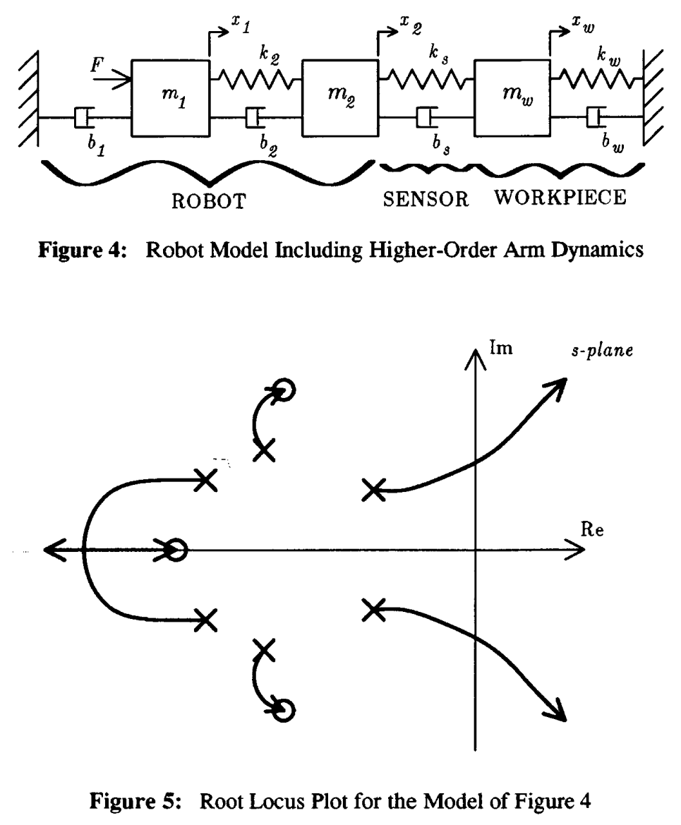
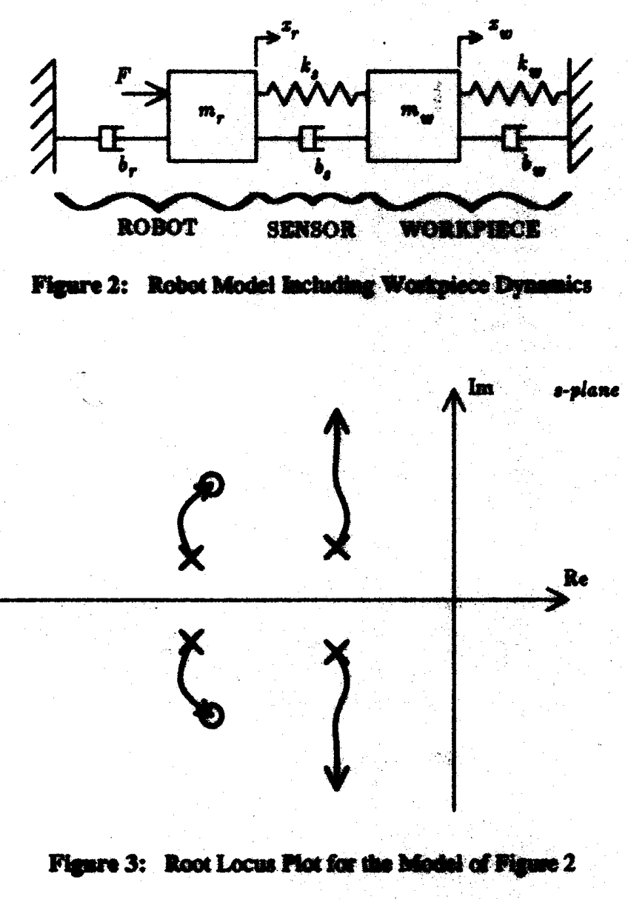
Force Control

Slide 21
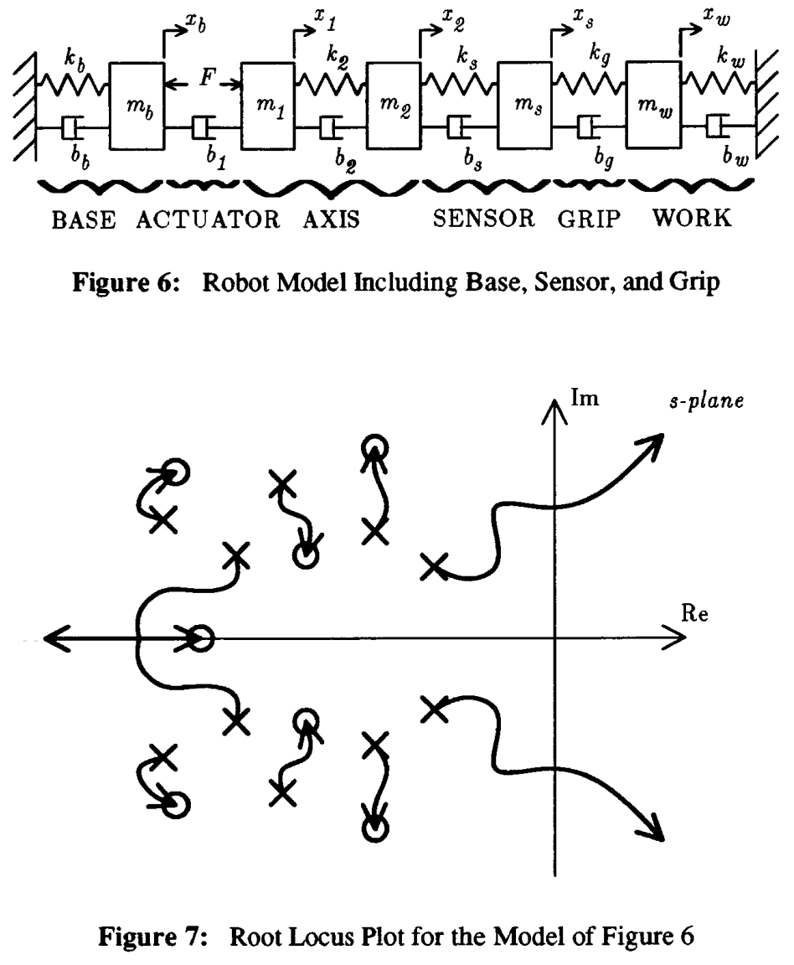


Slide 22
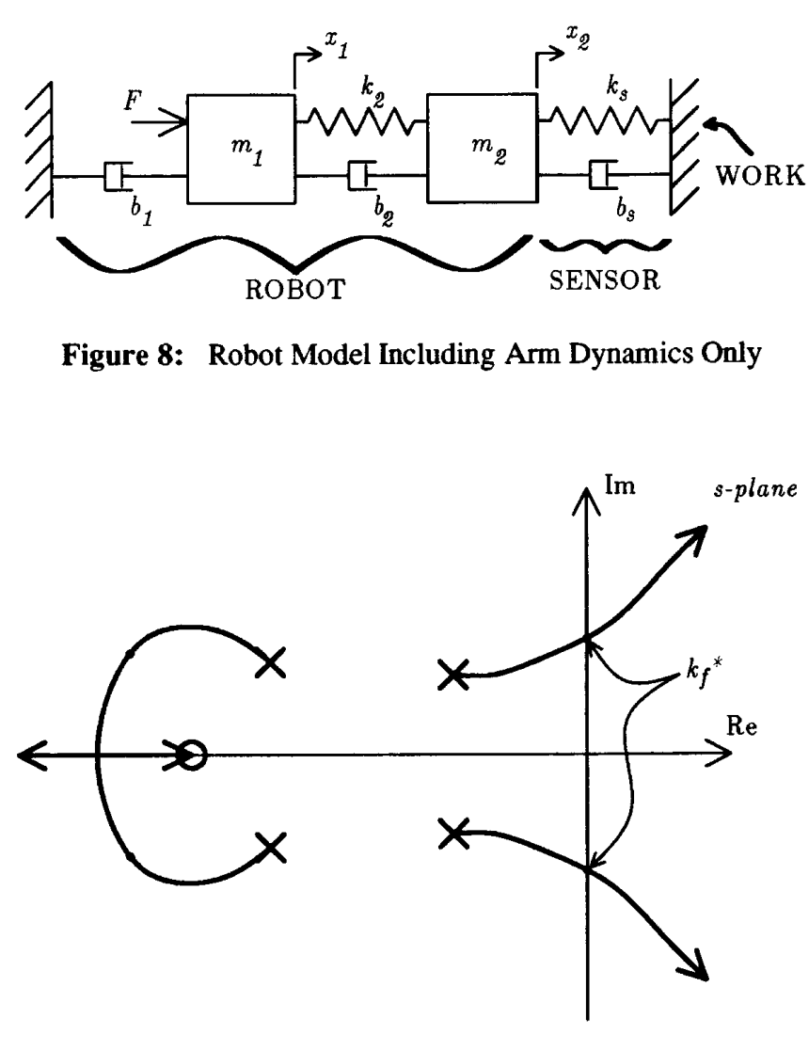
Force Control
The simplest model to explain non-collocation
The importance of the environment is not taken into account in this work. (it should!)

Slide 23
Part II: Compliant Control of Stiff Joints

Slide 24
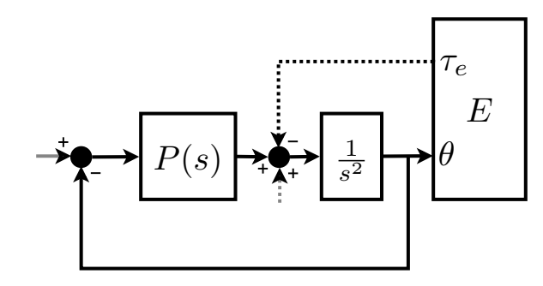
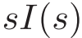
Implicit Impedance Control
Underlying ideas
A single position loop that stiffen the system as much as needed
It can be considered as an impedance architecture with open loop force control (truly negligible dynamics!!)
Notes:
There exist in the literature another impedance control approach which is actually more famed with respect to the previous architecture. This controller is called implicit because it doesn t make use of a force sensor but delivers forces in open loop basing on a very accurate robot model. If we reduce this controller to the single dof linear case we loose the need for such robot model (which basically account for the nonlinear dynamics) and we can see that the iic is basically made of a single position loop that directly implements the desired impedance.

Slide 25
Implicit Impedance Control
Advantages
No force sensor necessary
Very robust because it skip force control issues
Can also be very accurate
Disadvantages
Motor backdrivability is necessary
Low motor inertia and friction are strongly desired
An accurate model of the robot is necessary this cannot be explained in the 1 d.o.f. case

Slide 26
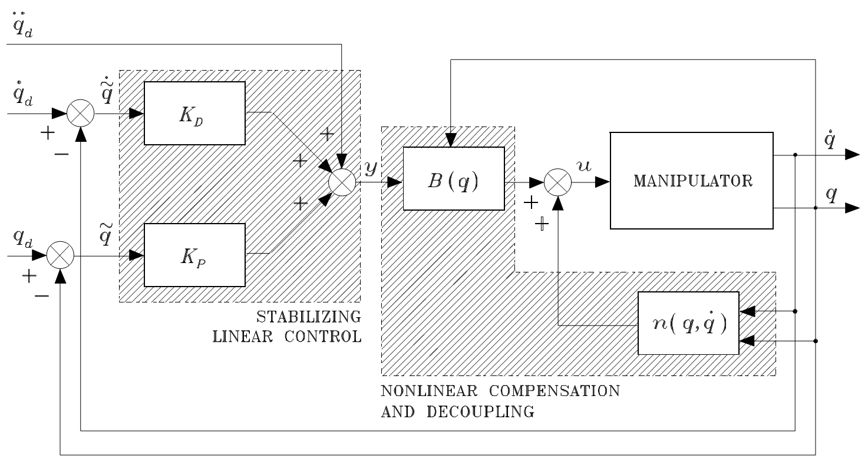
Implicit Impedance Control
On multi d.o.f. robots requires Inverse Dynamics compensation

Slide 27
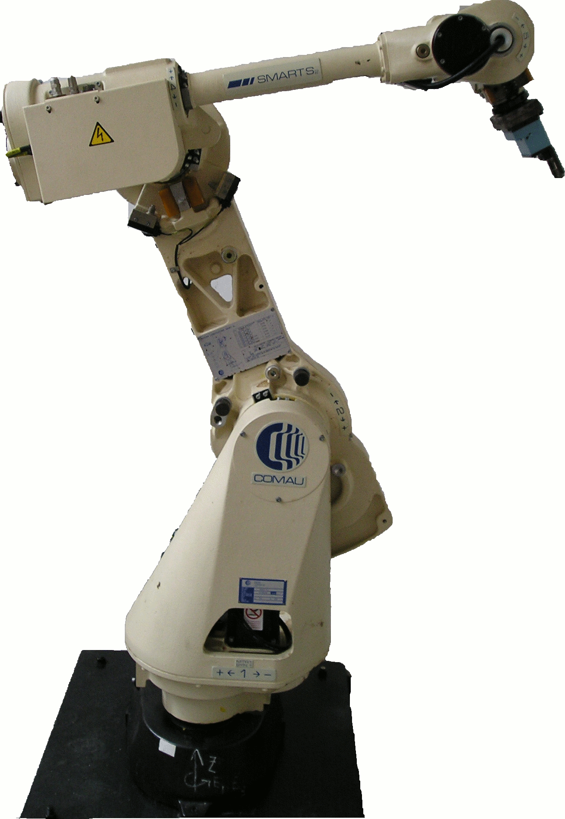
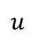
$$u$$
ID compensation
ID compensation

Slide 28
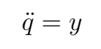
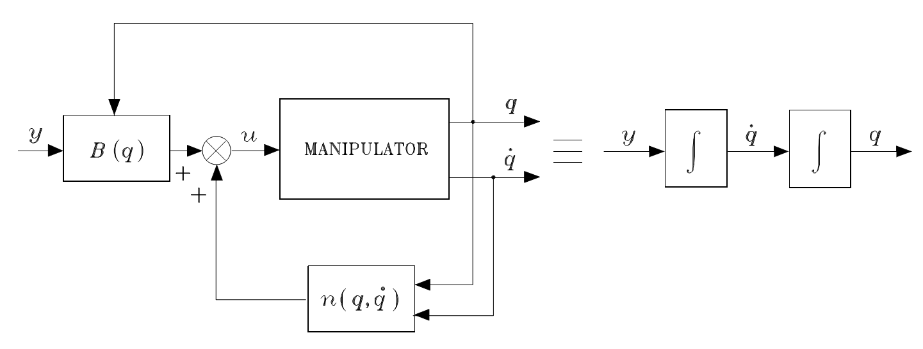
Implicit Impedance Control

Slide 29
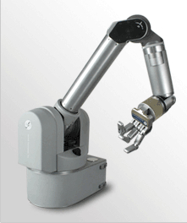
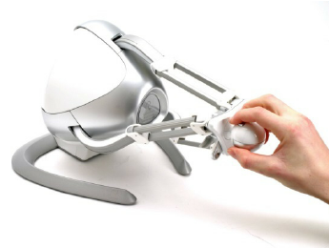
Implicit Impedance Control
History & Curiosity:
The Implicit Impedance Control concept was introduced in ‘85 in the famed Hogan’s paper “Impedance Control: An Approach to Manipulation”
Used in direct-drive robots
Such as Barret WAM, and in most of haptic interfaces
Notes:
About the hystori of the iic architecture it was introduced in the famed paper by hogan … which represent a milestone for interaction control research.

Slide 30
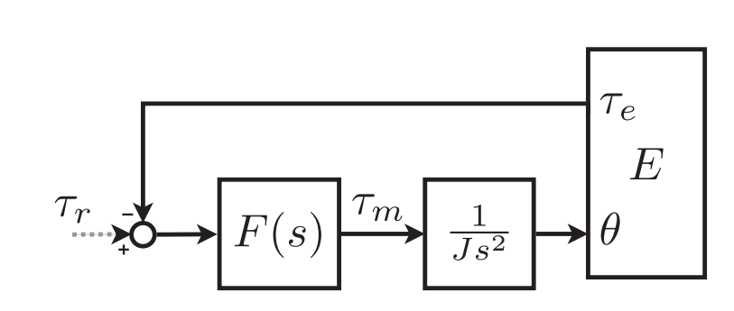
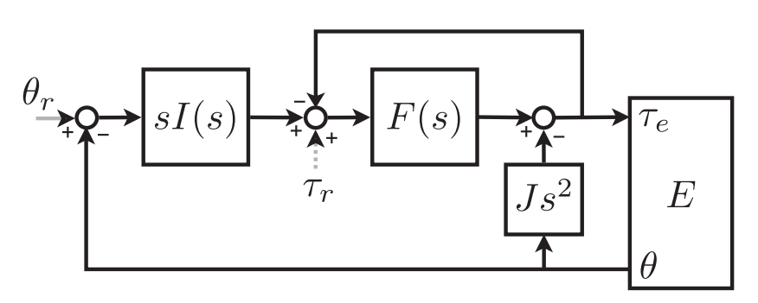
Impedance Control
Underlying ideas:
The inner force loop reduces inertial and friction dynamics
The outer position loop shapes the force-position relation
Force Control
(equivalent
representation)
Notes:
Impedance control architecture is dual to admittance control and uses an inner force loop and an outer position based loop to shape the robot impedance. Also here the dynamics of the inner loop should be very fast if we want this impedance relation to be effectively implemented. Unfortunately as I told you before it is quite hard ti implement an high performance force loop on a stiff mechanics so that this control architecture is referred to be very accurate in force but less robust or more in general we need to say that exist a accuracy robustness trade off.
Also note that in impedance control the robot is coupled with an admittance like environment and the robot causality in inverted. While if we recall the admittance control schema we have the dual representation.

Slide 31
Impedance Control
Underlying ideas (dual to admittance control):
The outer position loop shapes the force-position relation
The inner force loop is supposed to be very fast (true?)
Force Control
(equivalent
representation)
Notes:
NOTE: P should influence the perceived stiffness. Try with a feed-forward.
Impedance control architecture is dual to admittance control and uses an inner force loop and an outer position based loop to shape the robot impedance. Also here the dynamics of the inner loop should be very fast if we want this impedance relation to be effectively implemented. Unfortunately as I told you before it is quite hard ti implement an high performance force loop on a stiff mechanics so that this control architecture is referred to be very accurate in force but less robust or more in general we need to say that exist a accuracy robustness trade off.
Also note that in impedance control the robot is coupled with an admittance like environment and the robot causality in inverted. While if we recall the admittance control schema we have the dual representation.

Slide 32
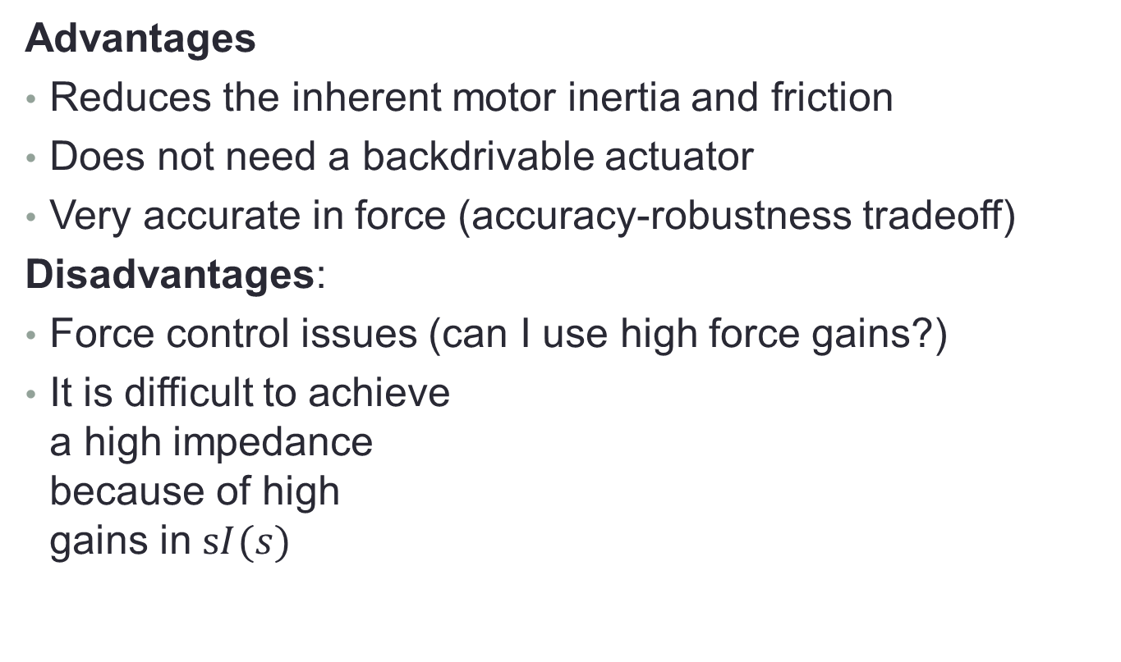
Impedance Control
Advantages
Reduces the inherent motor inertia and friction
Does not need a backdrivable actuator
Very accurate in force (accuracy-robustness tradeoff)
Disadvantages:
Force control issues (can I use high force gains?)
It is difficult to achieve a high impedance because of high gains in $sI(s)$
Notes:
The main advantages of impedance control are
The force accuracy thanks to the inner force loop as I explaine before
The fact that doesn t need … thanks again to the inner force loop
However it suffers from classic force control issues that can be partially overcomed by using advanced force control methods and high bandwidth actuators.
Also …

Slide 33
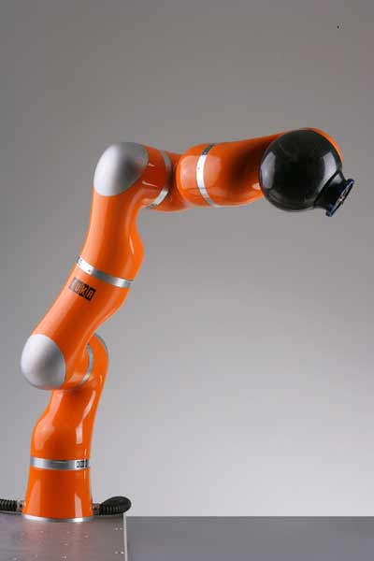
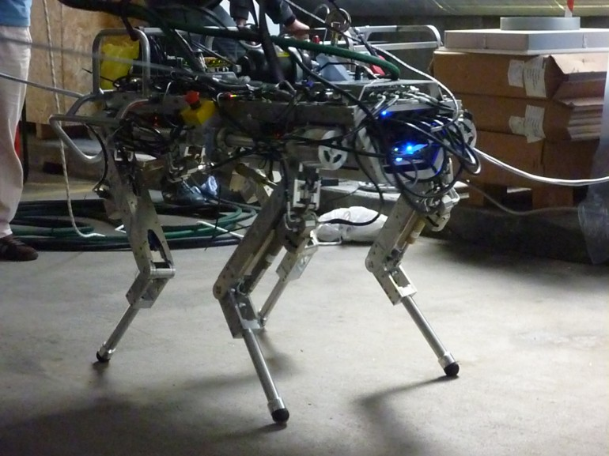
Impedance Control
History & Curiosity:
Impedance schemas appeared in the literature only recently (‘90s) because of force control issues
Force control is today improved by torque sensing at the joint level, by low digital delays, and by advanced force control schemas
Quite popular even in hydraulically actuated robots
Notes:
About the hystory of this architecture we have that it is quite recent because torque controlled robots have been quite recently spread on the marked and in research labs. And this is mainly because …
Interestingly I found that the impedance architecture is very popular on hydraulic robots. Here you can see a picture of the HyQ robot but I think that even the big dog and the petman are based on a similar principle.

Slide 34
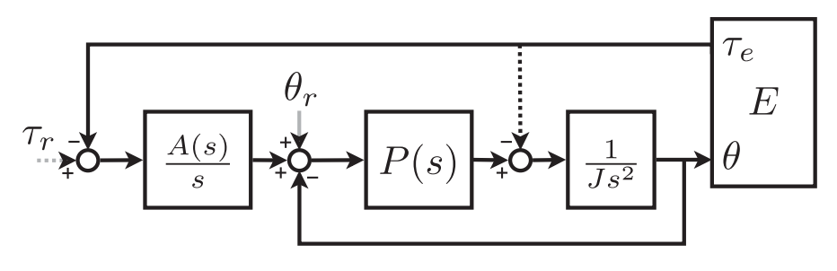
Admittance Control
Underlying ideas:
The outer force loop shapes the force-position relation
The inner position loop is supposed to be fast
Notes:
The first compliant controller ever proposed is admittance controller represented in figure. In our notation we represent the robot as a pure inertial element as we refer to a single dof.
the black dotted arrows represent backdrivability which can be present or not.
Also the short gray arrows represent position and force references … We will se more in detail the meaning of these reference.
About the admittance architecture you can see that it is based on an inner position feedback and …
Basically the role of the outer loop is to shape shapes the force-position relation while the nner position loop is to be as fast as possible so that the desired admittance can be is almost instantaneously over-imposed.

Slide 35
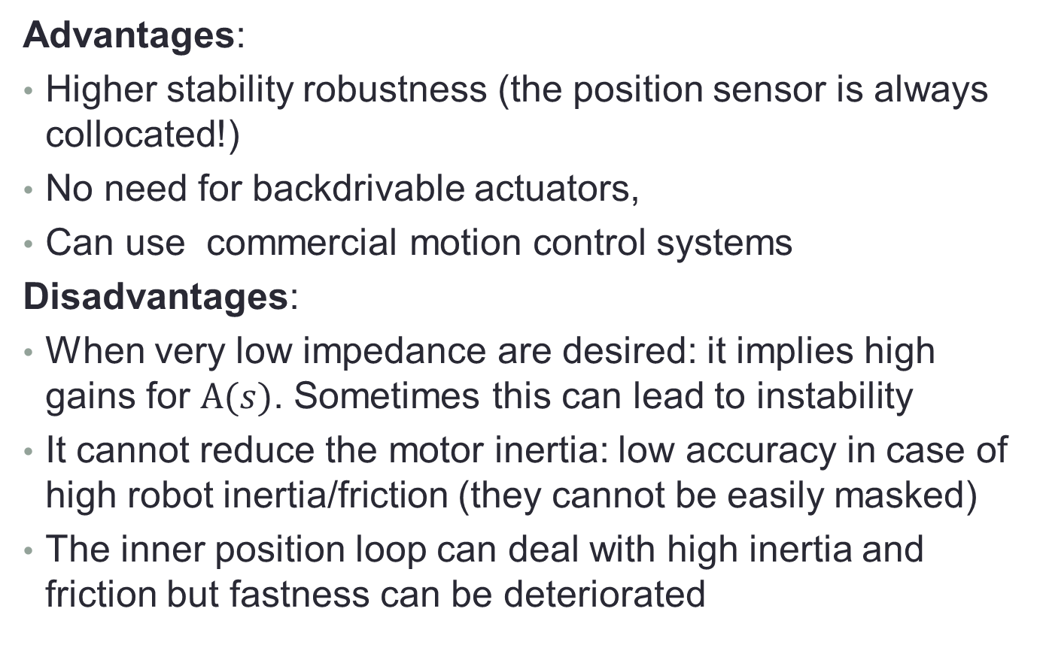
Admittance Control
Advantages:
Higher stability robustness (the position sensor is always collocated!)
No need for backdrivable actuators,
Can use commercial motion control systems
Disadvantages:
When very low impedance are desired: it implies high gains for $A(s)$. Sometimes this can lead to instability
It cannot reduce the motor inertia: low accuracy in case of high robot inertia/friction (they cannot be easily masked)
The inner position loop can deal with high inertia and friction but fastness can be deteriorated
Notes:
The main advantages of admittance control are
… thanks to the inner position loop
Also AC can be implemented by using … a the the inner level
Finally AC … thanks to the outer force loop
The main disadvantages of this architecture arises when a low impedance is desired. In this case we need to move the desired position very fast as an external force is sensed implying high gains for A(s).

Slide 36
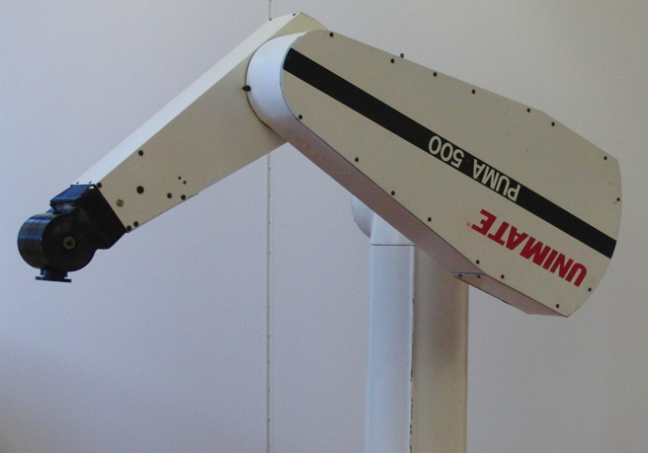
Admittance Control
History & Curiosity:
When in 1985 Whitney published his historical survey almost all the presented algorithms were instances of the admittance schema
Very popular in
industrial robots,
especially in the past.
Notes:
As I told before the admittance architecture is hystorically the first one. …
However the admittance implementation is still very popular in the case we use old style robot like for example industrial robots

Slide 37
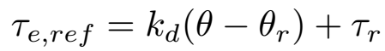






Position and Force References
In compliant control, position and force references do not define the desired position or force. They both determine the rest position of the desired impedance.
Let consider a virtual spring
Similar considerations can be done for the admittance case
The rest position $θ_{0}$ can be changed using only one reference!!
Notes:
In particular when the spring is in position \theta_{r} its compression will be \tau_{r}
In this schema the only think you can vary is the spring rest position!!
And the rest position can be changed using only one reference!!
It is redundant to specify both values!!

Slide 38

Admittance or Impedance?
Notes:
Finally in this table I collected several results on the proprieties of admittance and impedance controllers and to provide a guideline for choosing the best implementation.
Of courses it is not possible to go deep into all these results but we can easily make some observation.
For example admittance control seem to be better to render high impedance and while impedance control seem better for low impedance.
Also the main advantage of ac is referred as robustness while ic seem to be more accurate in force (if we use the correct mechanics).
It has also been reported that stability is increases by robot compliance …, by robot friction …, and by actuator bandwidth …

Slide 39

Parallel Force/Position Control
Underlying ideas
Implicit switching mechanism between force and position
control (the force loop tuned to dominate the position loop) Leads to use position control in free space and to dynamically switch to force control in case of contact
It is a kind of impedance controller where the force
controller is excluded in the case of free motion
Notes:
Another kind of compliant controller that have been proposed for stiff robot is the pfp architecture which is very similar ti the ic architecture except that the force controller is not on the feed forward path but it is on the feedback path. This basically allow to exclude the force controller in free motion, where the sensed torque is zero, and apply an almost pure position controller. On the other hand as a force is sensed the signal goes in the feedback path and the controller behaves very similarly to the ic case.
In the end we can say that exept for this implicit switching mechanism the pfp architecture is a kind …

Slide 40
Part III: Compliant Control of SOFT Joints
Notes:
Now we are …

Slide 41

Soft Joints
Series Elastic Actuators (SEAs) can be considered the most representative example of soft joints
A very simple idea: applying a linear spring in series with electric or hydraulic motors (MIT laboratory)[Pratt1994]
Quite bad for position control
Very good for force control
Compliant Control of soft Joints
Inner force control loop (high accuracy and robustness)
Collocated inner position loop (on the motor!)
Notes:
…
And as we told before if on one hand they are quite bad for position control because of non collocation
On the other hand they provide very robust force control

Slide 42


Force Control of Soft Joints
Existing Force Control Implementations
Linear Passivity Based
[Pratt94][Vallery08][Tagliamonte13]
Robust
Disturbance Observers
[Kong09]
Sliding-Modes
[Kong][Calanca14]
Adaptive
[Calanca14]
Notes:
And for this reason several force control algorithms have been proposed in the literature.
Several force controllers have been proposed like for example …
The most popular schemas are linear passivity based controller that are depicted in the slides. Basically we have a force control architecture that is based on a inner velocity feedback which is used to have a inner linearization of the system thanks to the compensation of stiction effects. Also we have another passive force control schema which is based on some feed-forward terms and an acceleration feedback which basically serves to have some prediction from the environments.

Slide 43

Impedance Control of Soft Joints
Underlying ideas:
The outer position loop shapes the force-position relation
Inner force loop is to be as fast as possible
Impedance Control of Stiff Joints
(just to compare)
Notes:
And given the fact that sea are very robust in force control it is a quite straight forward choice to clos an outer position based loop and design an impedance control architecture.
This architecture is actually very similar to the stiff joint case and the only difference between the schemas is that now we have the spring elasticity k *

Slide 44

Impedance Control
Advantages
Very accurate in force
Does not need an inherent backdrivable actuator
High stability robustness (no force control issues)
Disadvantages:
It is very difficult to achieve a high impedance because it results in high gain for $I\left(s\right).$ Moreover the feedback$θ$ is not collocated
Notes:
And also the advantage of this architecture are very similar to the stiff case …
But now we have both accuracy and robustness thanks to the improved force control robustness
On the other hand wrt the soft joint case here we have that it is even more difficult do display high impedances
Not only because …
But also …

Slide 45

Admittance Control of Soft Joints
Underlying ideas:
The outer force loop shapes the force-position relation
Inner collocated position (as fast as possible)
Admittance control on an extended environments which includes the spring
A(s) = an admittance that coupled to the spring will give the desired admittance
Notes:
And to overcame such non collocation issue two kind of controller have been proposed.
The first is a special version of the admittance architecture which uses an inner collocated motor feedback instead of the link feedback
And an outer force loop to shape the admittance considering an augmented environments which includes the spring
So basically here will not be implemented the desired admittance but a certain admittance that coupled to the spring will give the desired admittance

Slide 46

Admittance Control of Soft Joints
Advantages
Robustness to friction effects
Can use commercial motion control systems
Does not need an inherent backdrivable actuator
Disadvantages in case of desired
very low impedance: it implies high gains for $A(s)$
high impedance: we can only stiff the motor
... w.r.t. the physical spring!!
Notes:
The main advantage of the admittance controller are basically the same of the stiff joint case
But we have a further disadvantage because not only
But also we cannot achieve high impedances!! In particular higher impedance wrt the physical spring

Slide 47

Admittance Control of Soft Joints
So what it is useful for?
Middle impedances, lower but sill near to the physical spring
Motivation
Troody Robot Prototype
“Why closing a high gain force control, to get close to zero impedance, if we finally desire a high impedance?” [Pratt04]
Notes:
…
In fact the motivation is:
…

Slide 48


Parallel Force-Position Control
DLR LightWeight Arm Impedance Control
The harmonic drive stiffness and damping are explicitly considered in the control law
Modelled as series elastic (and damping) actuator
Notes:
Another kind of non collocated impedance control is the case of the impedance control of …
Despite this robot is not soft by design the harmonic drives …

Slide 49

Parallel Force-Position Control
DLR Lightweight Arm Impedance Control
The same torque measurement capabilities of SEAs
Parallel feedback of force and collocated position
Notes:
Also this robot has the same torque … meaning that forces can be measured at each joint like if we can measure spring compression
And here we have a control law which basically implement a parallel feedback of …

Slide 50

Parallel Force-Position Control
It is equivalent to an impedance controller
with collocated feedback!!
The force feedback reduces the apparent motor inertia
The position feedback stiffens the system as required
Not beyond the physical spring stiffness!!
Positive PD force and position gains guarantee coupled stability!!
Notes:
In the original paper this control law is explained in a equivalent collocated impedance controller
Where the inner force feedback …
And the outer position feedback is closed on the motor instead than at the link position
And within this control architecture we have the important result that positive …
This result derives from an energetic interpretation of the control law where the inner force feedback shapes the kinetic energy and the outer loop shapes the potential (virtual) elastic energy

Slide 51
Part IV: Discussion & Conclusions

Slide 52

Choosing between stiff and soft joints
Notes:
Finally we will briefly discuss when it better to use stiff or soft joint which of course it depends on the specific application
Even if we cannot go through any single literature result we can sketch some general guidelines
In general we have that a stiff joint usually are simpler to design and are a straight forward choice if you need very high impedances.
On the other hand soft joints have a more complicated mechanical design and should be chosen if you want to display low impedance with accurate force fidelity. And you can also have some advantage if elasticity is tailored to a specific task achieving improved efficiency or performance. Also you can be more safe because of shock tolerance and lower reflected inertia. In fact we have that in the stiff case the virtual compliance is lost when above the (inner loop) control bandwidth

Slide 53

Choosing between stiff and soft joints
Notes:
Also another interesting observation is that compliance does not means high force bandwidth but only higher force control gains and higher force control robustness.
On the other hand stiffness imply higher position bandwidth.
Also lets observe that in the case of stiff joints we have admittance control which is good for high impedance while impedance control is good for low impedance but it is not robust. This means we cannot robustly reach very low impedances.
On the other hand with soft joint control we cannot reach high impedance and we risk instability

Slide 54

Choosing between stiff and soft joints
“In practice, when a controller attempts to emulate dynamics that differs significantly from the intrinsic hardware dynamics, an increased risk of coupled instability arises; thus arbitrary impedances cannot be implemented.”
Buerger, S. & Hogan, N.
Notes:
Related to that exists a very related statement by hogan which tells us that …
And exactly the same concept can be explained by passivity analysis. In fact it has be proven that for the case of soft joint the desired stiffness and damping should be less than the physical ones.
And similar results exists in the case of stiff joints even if they are less immediate to understand. About what is passivity we will listen to nevio presentation for the moment I just give an intuitive definition by stating that

Slide 55




Stability Issues in Compliant Control
A stable system can risk instability when coupled with another stable system!!
We need another “stability concept” which assures stability when coupled with a quite generic environment
Notes:
You can notice that all the presented schemas represented a controlled robot coupled with an environment. Unfortunately we have that
…
Which basically means that stability of the robot is not a sufficient condition for compliant control
…
Such a concept is passivity and will be explained in detail in the next presentation

Slide 56
References
A. Calanca and P. Fiorini, “A Review of Algorithms for Compliant Control,” IEEE Transaction on Mechatronics, 2014.

Slide 57
Bibliography (stiff joints)
D. E. Whitney, “Force Feedback Control of Manipulator Fine Motions,” Trans. ASME J. Dyn. Syst. Meas. Control, vol. 99, no. 2, pp. 91–97, 1977.
N. Hogan, “Impedance Control: An Approach to Manipulation: Part I,II,III,” J. Dyn. Syst. Meas. Control, vol. 107, pp. 1–24, 1985.
D. E. Whitney, “Historical perspective and state of the art in robot force control,” Int. J. Rob. Res., pp. 262–268, 1987.
D. Lawrence, “Impedance control stability properties in common implementations,” in IEEE International Conference on Robotics and Automation, 1988, pp. 1185–1190.
H. Kazerooni and T. B. Sheridan, “Robust Compliant Motion for Manipulators , Part I : The Fundamental Concepts of Compliant Motion,” no. June, pp. 83–92, 1986.
G. Zeng, “An overview of robot force control,” Robotica, vol. 15, no. 15, pp. 473–482, 1997.
T. Valency and M. Zacksenhouse, “Accuracy/Robustness Dilemma in Impedance Control,” J. Dyn. Syst. Meas. Control, vol. 125, no. 3, pp. 310–319, 2003.
S. Buerger and N. Hogan, “Relaxing Passivity for Human-Robot Interaction,” 2006 IEEE/RSJ Int. Conf. Intell. Robot. Syst., pp. 4570–4575, Oct. 2006.

Slide 58
Bibliography (soft joints)
G. A. Pratt and M. M. Williamson, “Series Elastic Actuators,” in International Conference on Intelligent Robots and Systems, 1995, vol. 1, pp. 399–406.
G. A. Pratt, P. Willisson, and C. Bolton, “Late motor processing in low-impedance robots: Impedance control of series-elastic actuators,” in American Control Conference, 2004, pp. 3245–3251.
A. Albu-Schäffer, C. Ott, and G. Hirzinger, “A Unified Passivity-based Control Framework for Position, Torque and Impedance Control of Flexible Joint Robots,” Int. J. Rob. Res., vol. 26, no. 1, pp. 23–39, 2007.
H. Vallery, J. Veneman, E. H. F. van Asseldonk, R. Ekkelenkamp, M. Buss, and H. van Der Kooij, “Compliant actuation of rehabilitation robots,” IEEE Robot. Autom. Mag., vol. 15, no. 3, pp. 60–69, Sep. 2008.
K. Kong, S. Member, and J. Bae, “Control of Rotary Series Elastic Actuator for Ideal Force-Mode Actuation in Human-Robot Interaction Applications,” IEEE/ASME Trans. Mechatronics, vol. 14, no. 1, pp. 105–118, 2009.
J. Bae, K. Kong, and M. Tomizuka, “Gait Phase-Based Smoothed Sliding Mode Control for a Rotary Series Elastic Actuator Installed on the Knee Joint,” in American Control Conference, 2010, pp. 6030–6035.
N. L. Tagliamonte and D. Accoto, “Passivity Constraints for the Impedance Control of Series Elastic Actuators,” J. Syst. Control Eng., vol. 228, no. 3, pp. 138–153, 2013.

